Slide 1


LOAN ELIGIBLITY PREDICTION
-Kalyani Avhale(242062001)
Guided By –
Prof. Ashwini Matange

Slide 2
Predict Loan Eligibility for Dream Housing Finance company
CONTENTS
Problem Statement Machine Learning Workflow Data Collection Data dictionary R- Libraries used Exploratory Data Analysis Model Building Baseline model Build the model Train the model Performance Metrics Measurement Predictions Summary

Slide 3
PROBLEM STATEMENT
Dream Housing Finance company deals in all home loans. They have a presence across all urban, semi-urban, and rural areas. Customer-first applies for a home loan after that company validates the customer eligibility for a loan.
The company wants to automate the loan eligibility process (real-time) based on customer detail provided while filling the online application form. These details are Gender, Marital Status, Education, Number of Dependents, Income, Loan Amount, Credit History, and others. To automate this process, they have given a problem to identify the customer's segments, those are eligible for loan amount so that they can specifically target these customers. Here they have provided a partial data set.

Slide 4

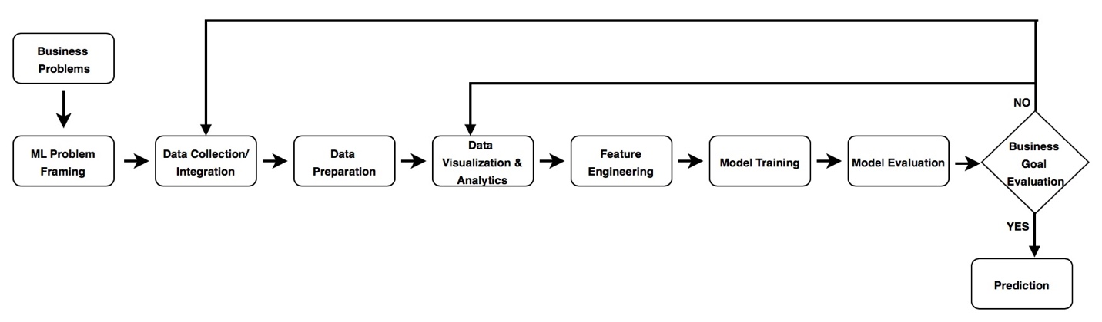
Machine Learning Workflow

Slide 5


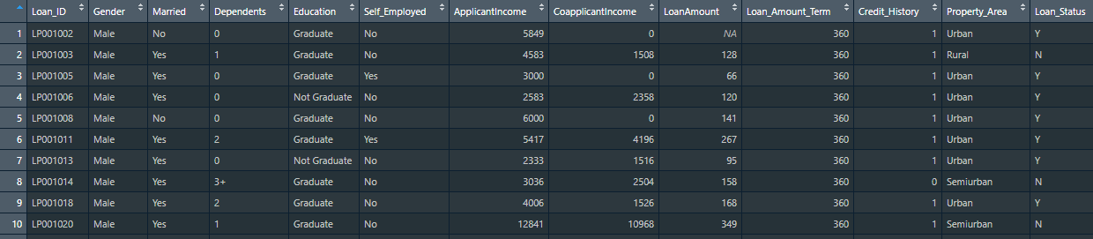
Data Collection
Source -
Language -
Train Data Dimensions :
614 rows and 13 columns
Test Data Dimensions :
367 rows and 12 columns
Link :
https://www.kaggle.com/vikasukani/loan-eligible-dataset

Slide 6
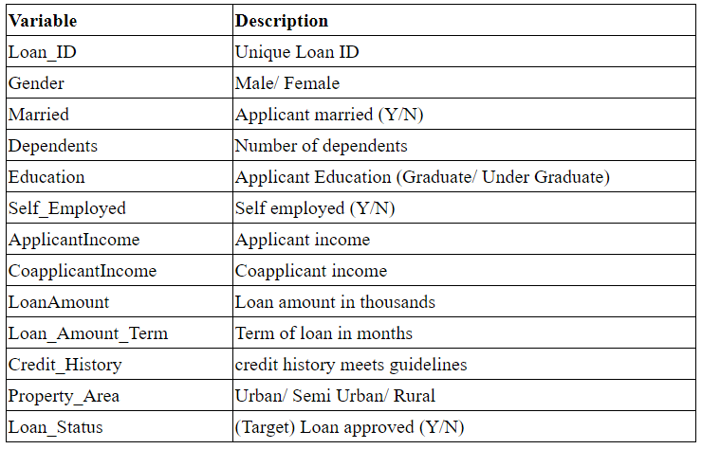
Data Dictionary
Predictors
Target (Binary yes / no output )

Slide 7
R Libraries used
library('tidyverse’) # metapackage of all tidyverse packages
library('dplyr') #data manuplation(included in tidyverse)
library('caret') #for Classification and regression
library('ggpubr') #arranging plots into grids
library('modeest’) #Estimation of the mode
library('ggplot2’) #for plotting graphs(included in tidyverse)
library('ggcorrplot’) #for plotting correlation matrix
library('randomForest’) #Random forest
library('xgboost') #Gradient Boosting

Slide 8

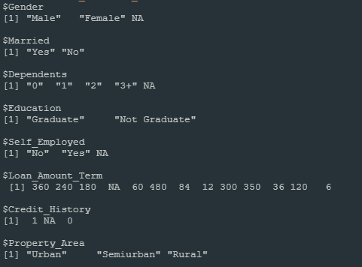
Data Cleaning/Pre-processing
Pre-processing Task:
Check if any duplicate values are present
Handle incorrect suffix in Dependents Var
Handle Categorical features
Null Value Imputation

Slide 9
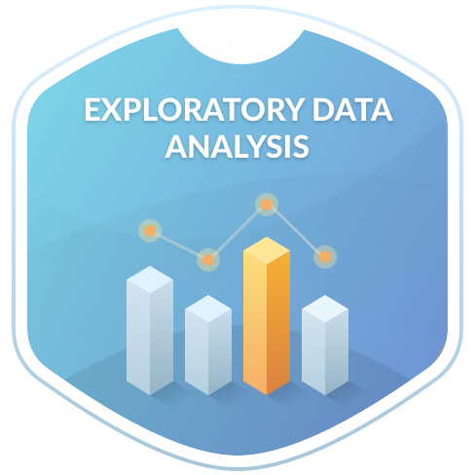

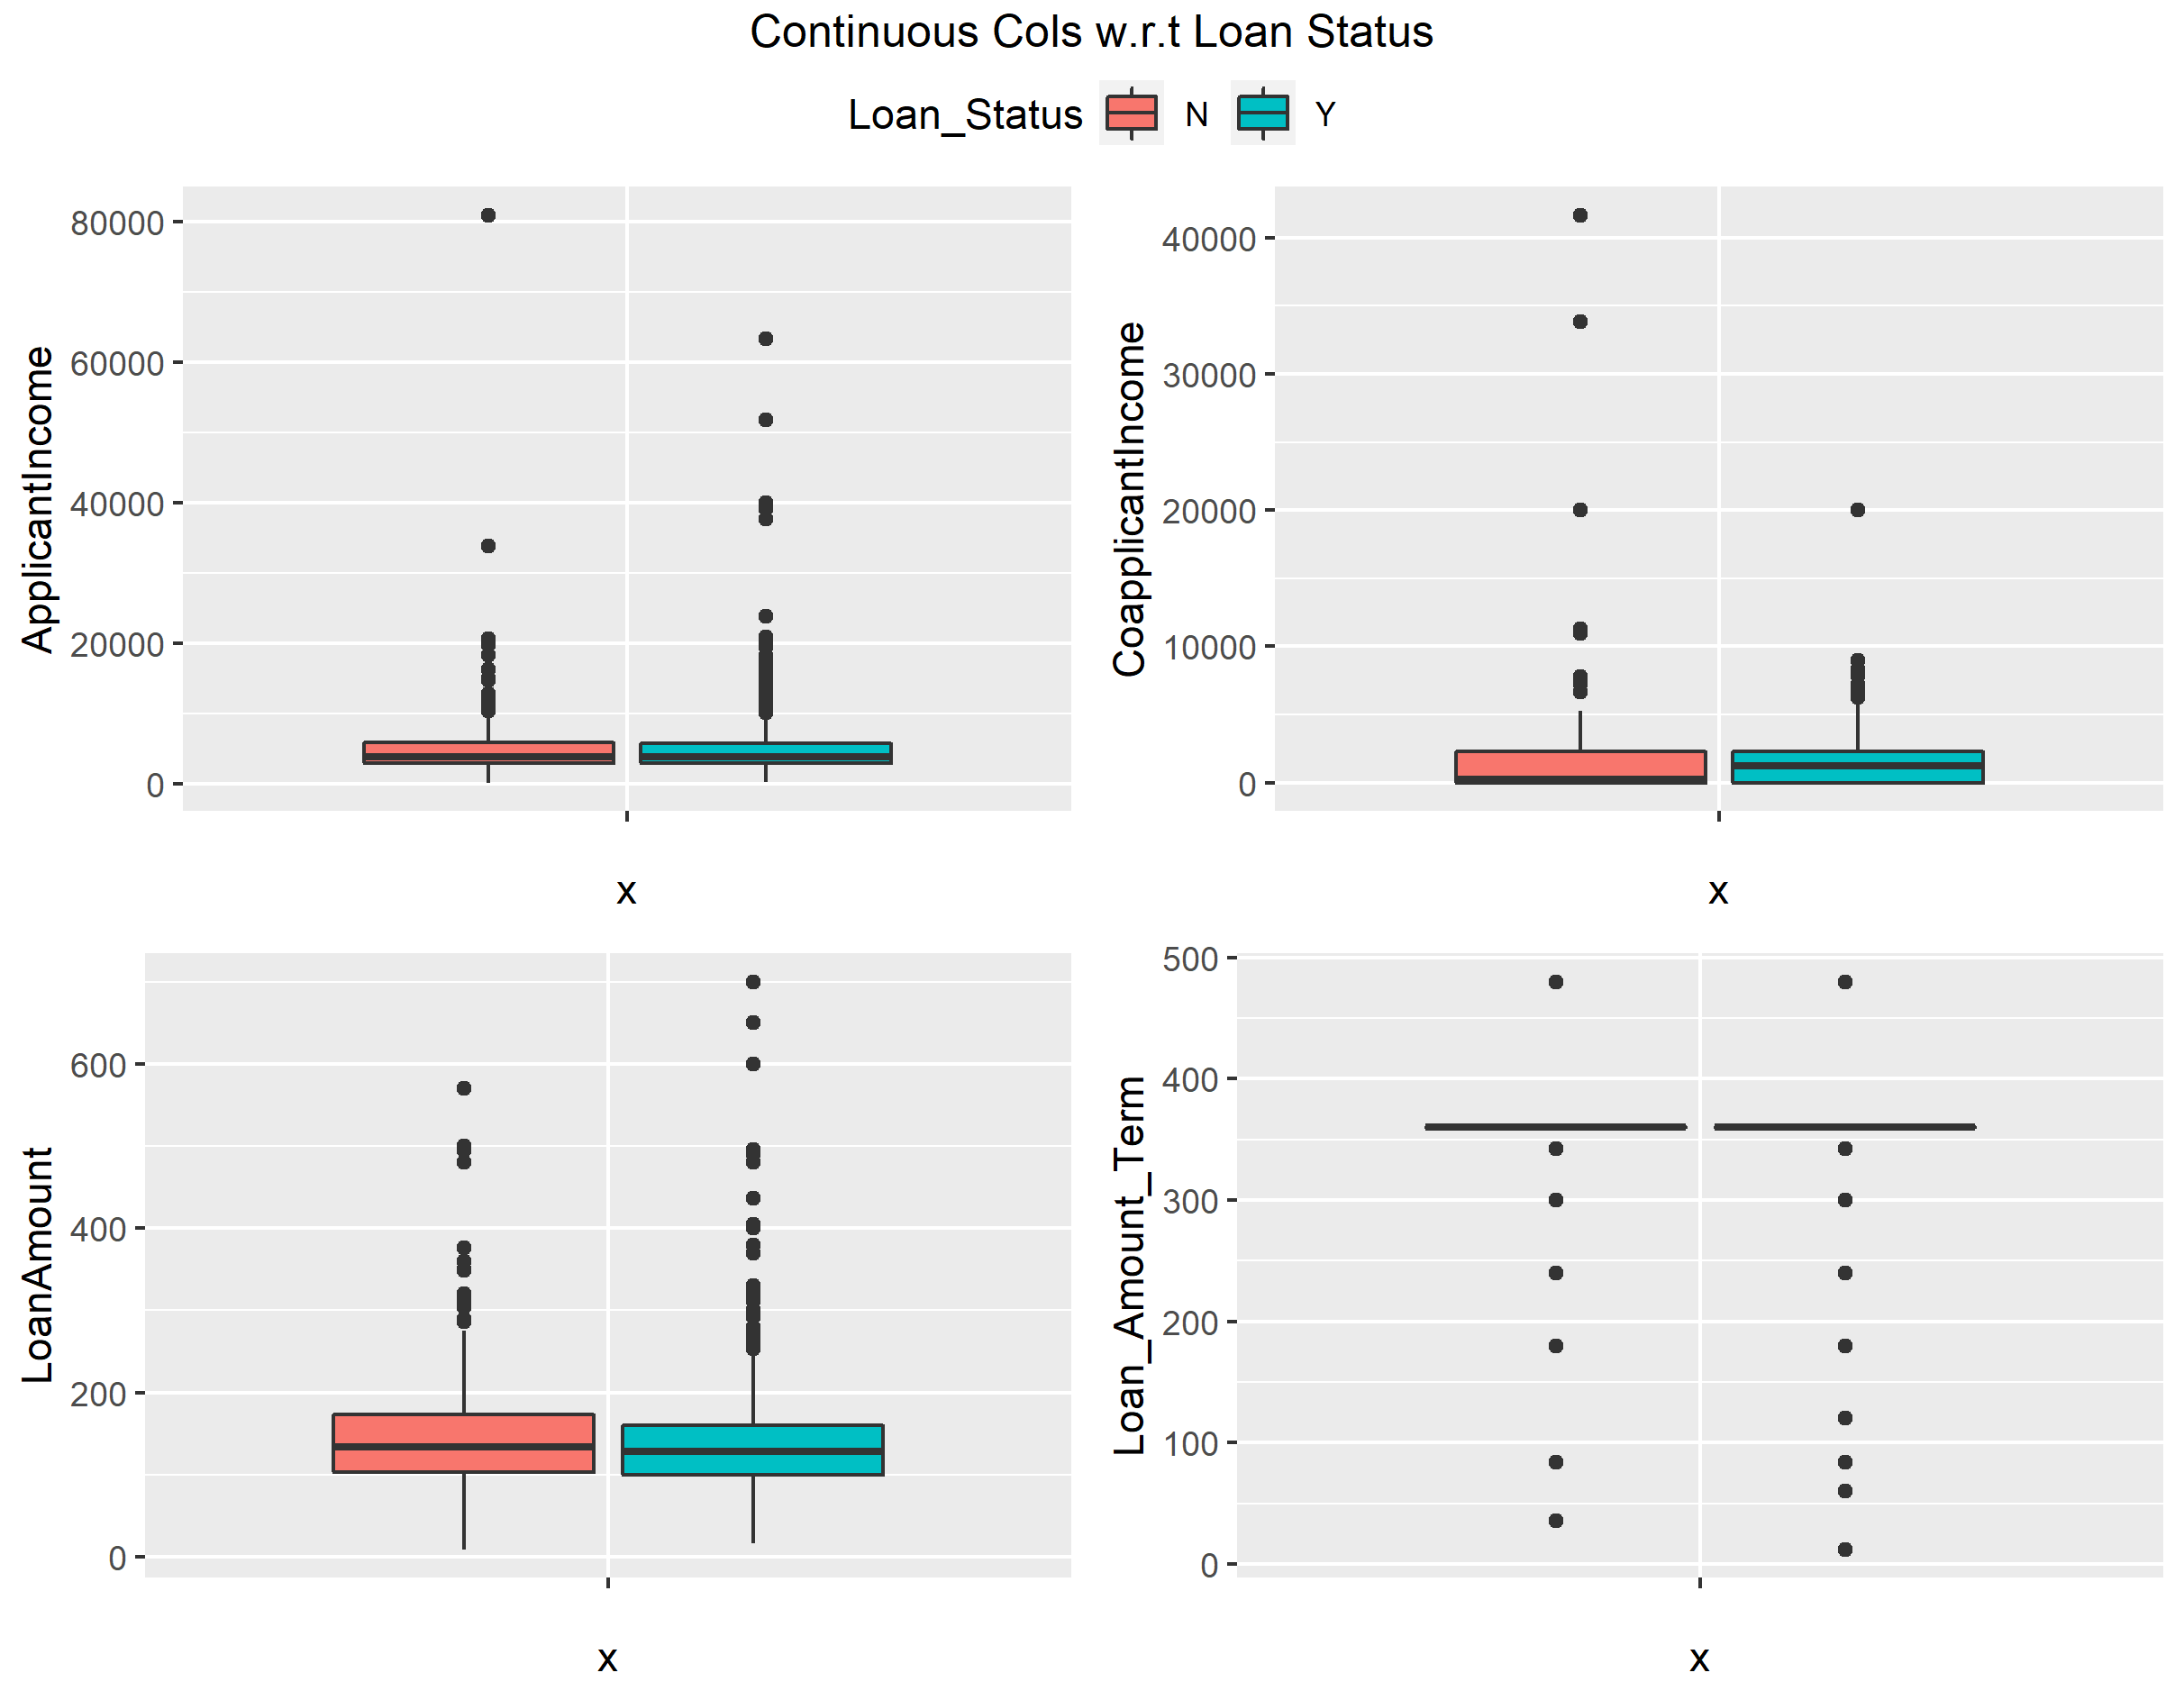
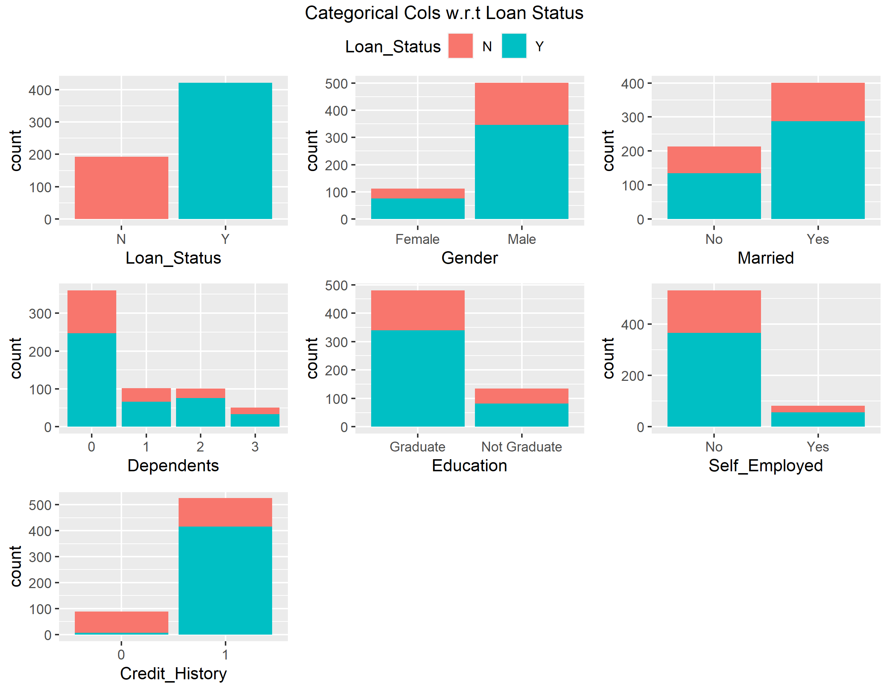
Exploratory Data Analysis
Data Visualization
Inference :
Male applicant has high loan approval
Applicant with 0 dependents has been approved with loan as compared to applicants with dependents
Self-employed applicants with loan approval are low as compared with which are not self employed(job seekers)
Applicant with Credit History has highest loan approval

Slide 10
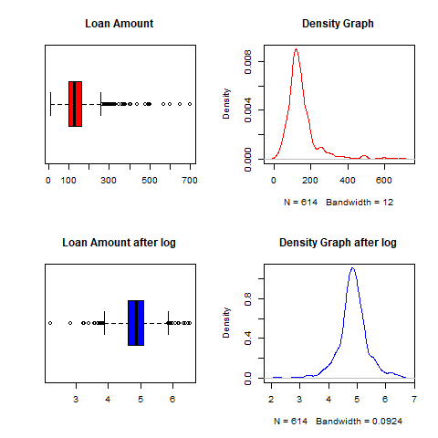
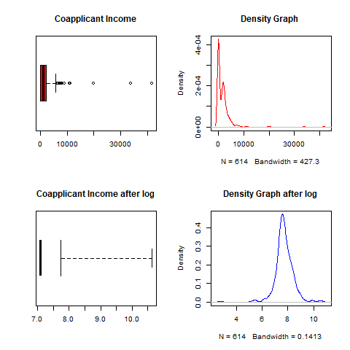
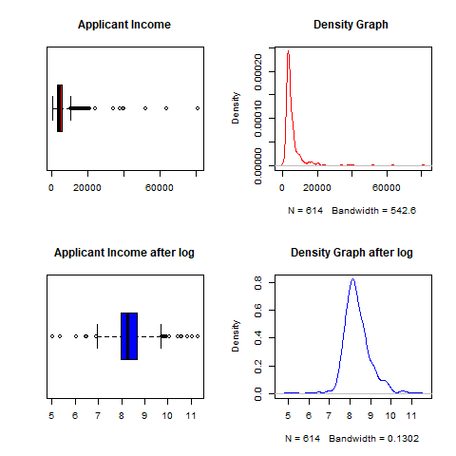
Exploratory Data Analysis
Skewness of the data is removed(data is normalized) using log()

Slide 11
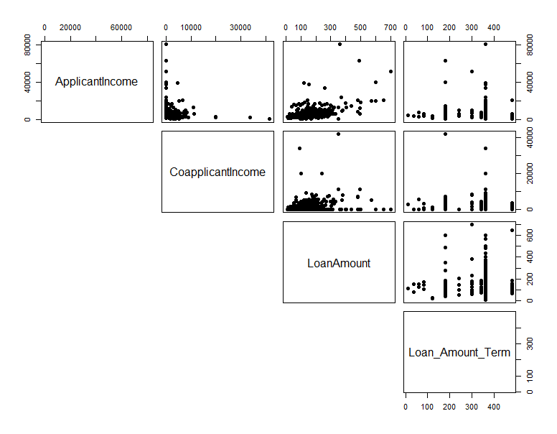
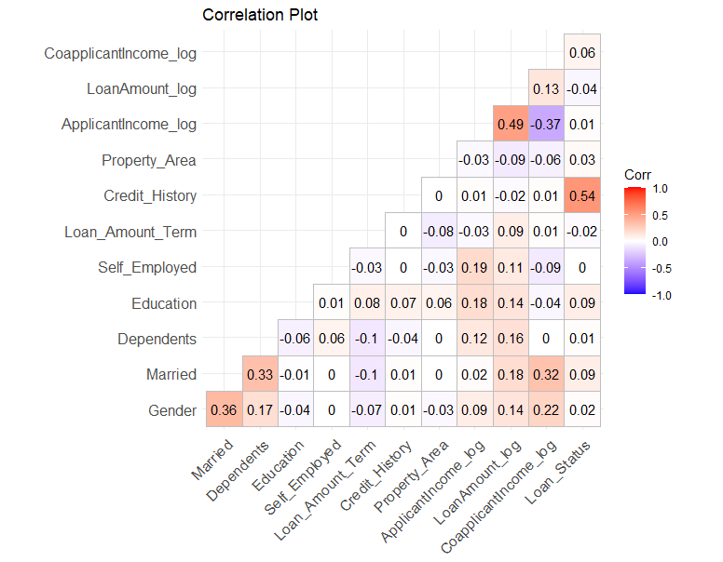
Exploratory Data Analysis
We have +ve correlations : LoanAmount and ApplicantIncome and LoanAmount and CoapplicantIncome
Credit History has strong relation with target feature Loan status approval (that logical !)

Slide 12

Model Building
Baseline Model :
Baseline accuracy : 69%
Train Model
Fitting the different models with train data
Evaluate Model
Evaluation metrics : Accuracy to check goodness of model
Prediction
Perform Predictions on unseen data

Slide 13

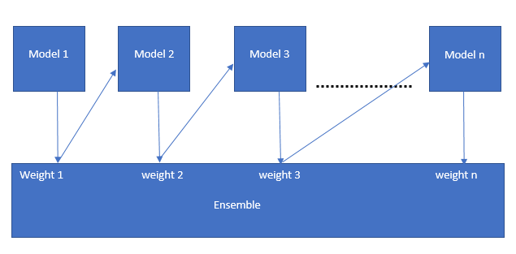
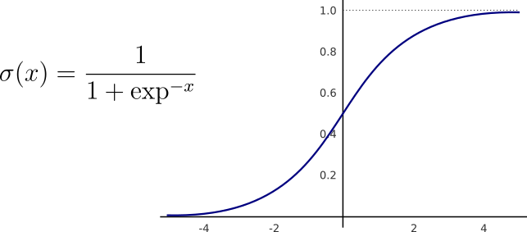
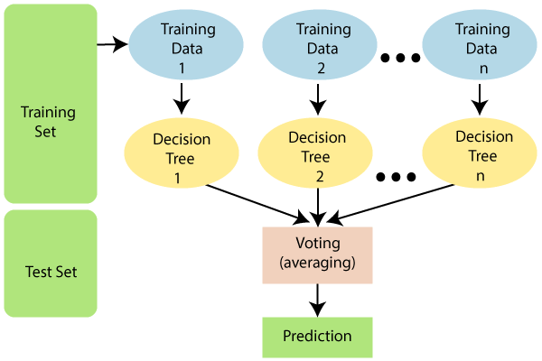
Machine Learning Algorithms
Logistic Regression
Random Forest
Gradient Boosting
Accuracy : 0.7922
Accuracy : 0.7978261
Accuracy : 0.7532

Slide 14

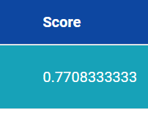
Predictions
Accuracy Score on Public data(unknown data)

Slide 15

Summary
Started from data cleaning and processing, missing value imputation , then exploratory analysis and feature engineering, and finally model building and evaluation.
The best accuracy we obtained on our validation data is 0.7792 ,Since dataset is not huge enough models performance does not vary but Random forest performed with hyperparameter tunning.
The insights about loan approval status from the analysis is:
Applicants with credit history not passing guidelines mostly fails to get approved, probably because that they have a higher probability of not paying back.
Most of the time, applicants with high income, loaning low amount is more likely to get approved, which makes sense, those applicants are more likely to pay back their loans.
Having a strong co-applicant can be a plus to the probability of getting approve.

